Slide 1
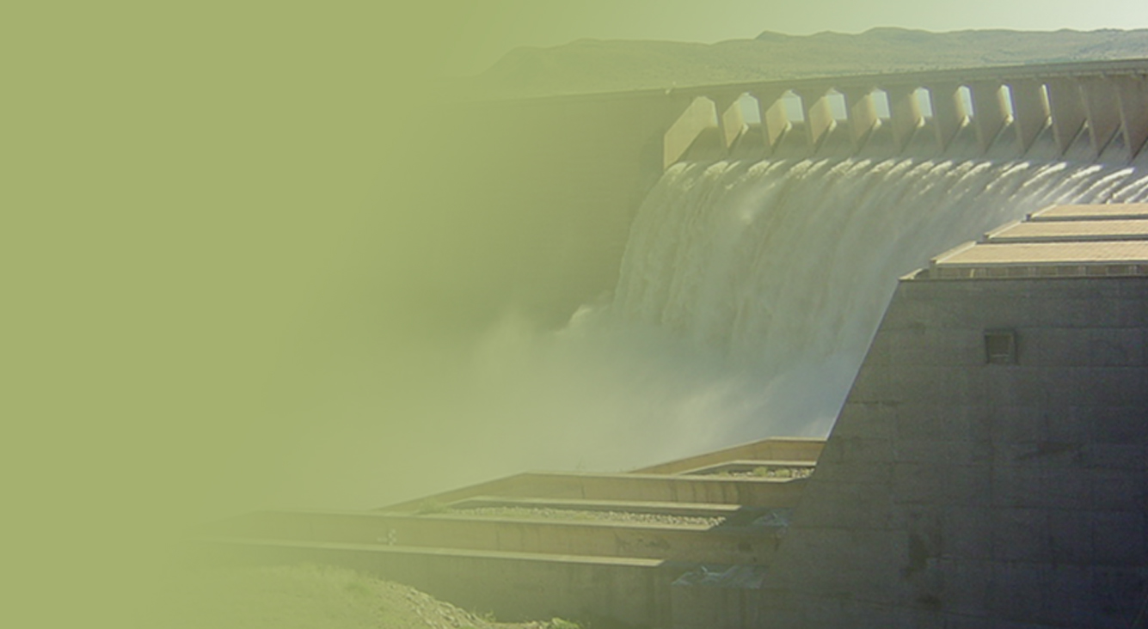
The Determination of Water Resources Classes and Resource Quality Objectives for the water resources in in the Breede-Gouritz WMA
Focus on Breede-Overberg area
Technical Task Group meeting 2: Presentation and workshopping of draft Resource Quality Objectives
Overview of the RQOs Process
Presented by: Erik van der Berg
12-16 March 2018
Graham & Rhona Beck Skills Centre, Robertson

Slide 2
Study Objectives
Co-ordinate implementation of the Water Resources Classification System (WRCS):
Determine Water Resources Classes (WRCs)
Determine Resource Quality Objectives (RQOs)
Support Gazetting of Recommended Water Resources Classes and RQOs
for the water resources in the Breede-Gouritz WMA:
- Rivers - Estuaries - Groundwater
- Dams - Wetlands

Slide 3
Objectives of the TTG Meeting
Provide overview of:
Study progress to date
Approach followed to determine RQOs
Present and workshop RQO findings:
Prioritisation of Resource Units (RUs)
Evaluation of Resource Units (prioritised RUs)
RQOs for Resource Units (prioritised RUs)

Slide 4
TTG Meeting arrangements
Mon 12 – Wed 14 March: Breede-Overberg
Robertson
Thu 15 – Fri 16 March: Gouritz Coastal
George
Separate work sessions for resource types:
Surface water, estuaries, dams, wetlands & groundwater
Different agenda each day

Slide 5
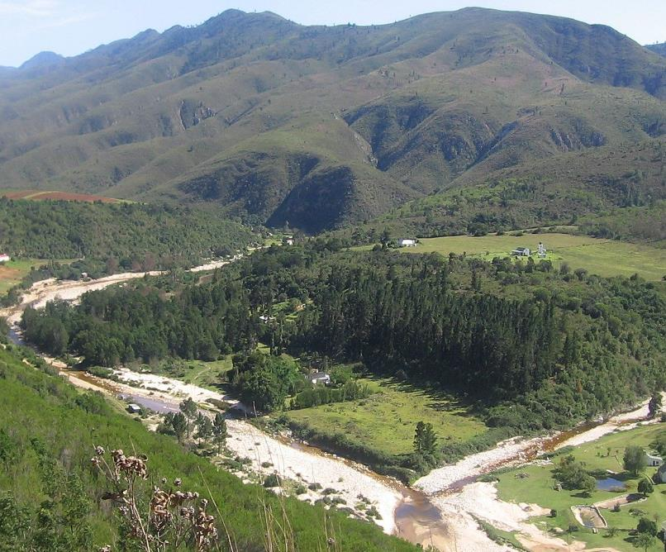
Overview of Study Progress

Slide 6
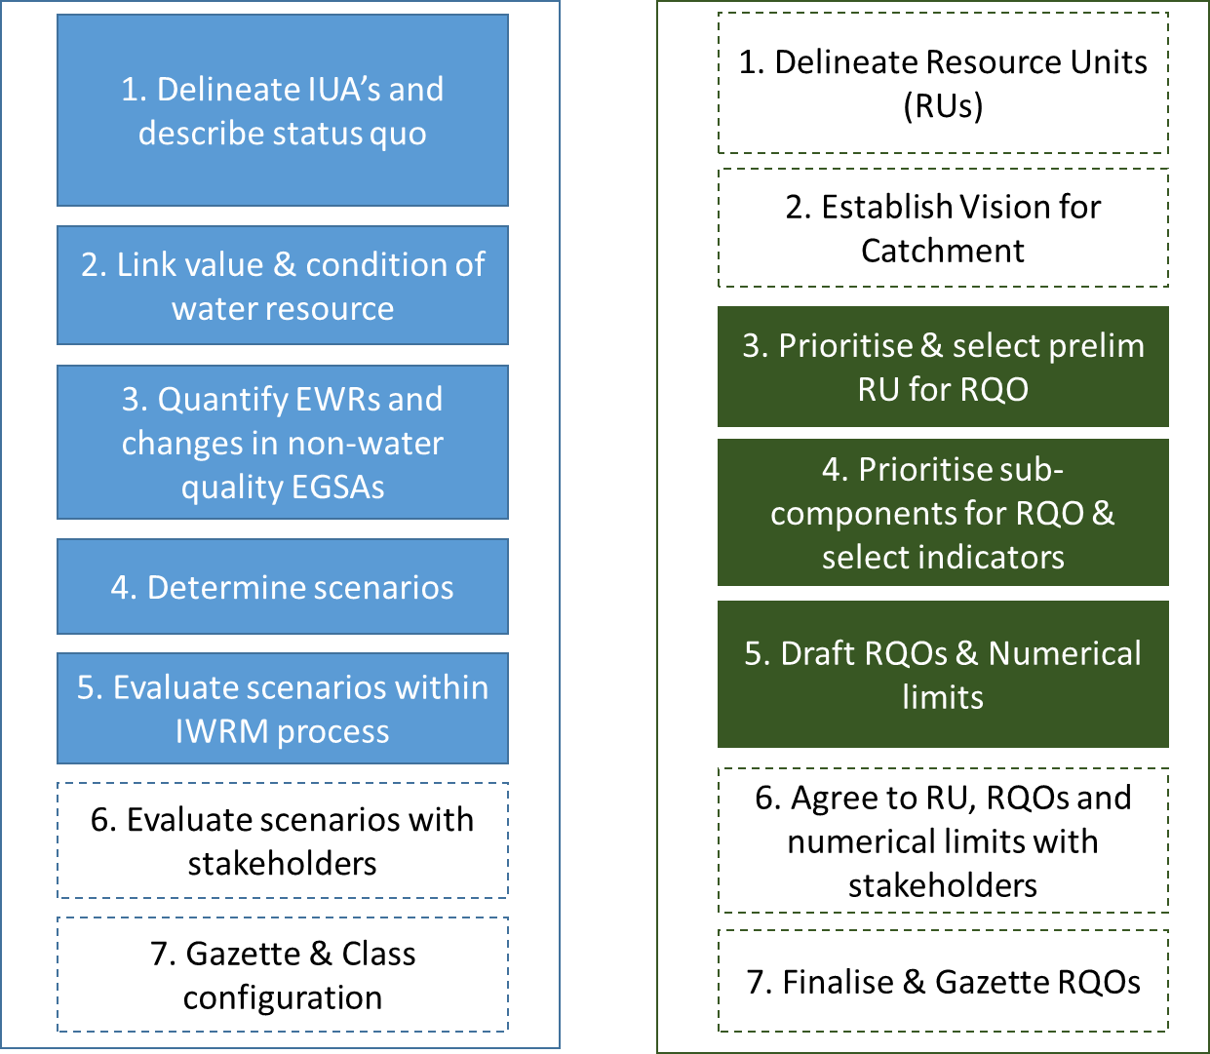
Classification and RQOs Steps
7-step process to determine WRCs
7-step process to determine RQOs
Aligned
Gazette WRC & RQO

Slide 7
Defined Integrated Units of Analysis (IUAs)
Identified significant resources:
Based on Physical, Biological & Socio-economic factors
Each IUA represents a similar area requiring a Water Resources Class (WRC)
Why do we need these?
Broad-scale units to assess socio-economic implications of scenarios (possible future situations)
Report on ecological conditions at a sub-catchment scale
Set WR Classes for different parts of a catchment
18 IUAs delineated - 10 in the Breede-Overberg & 8 in the Gouritz-Coastal areas

Slide 8
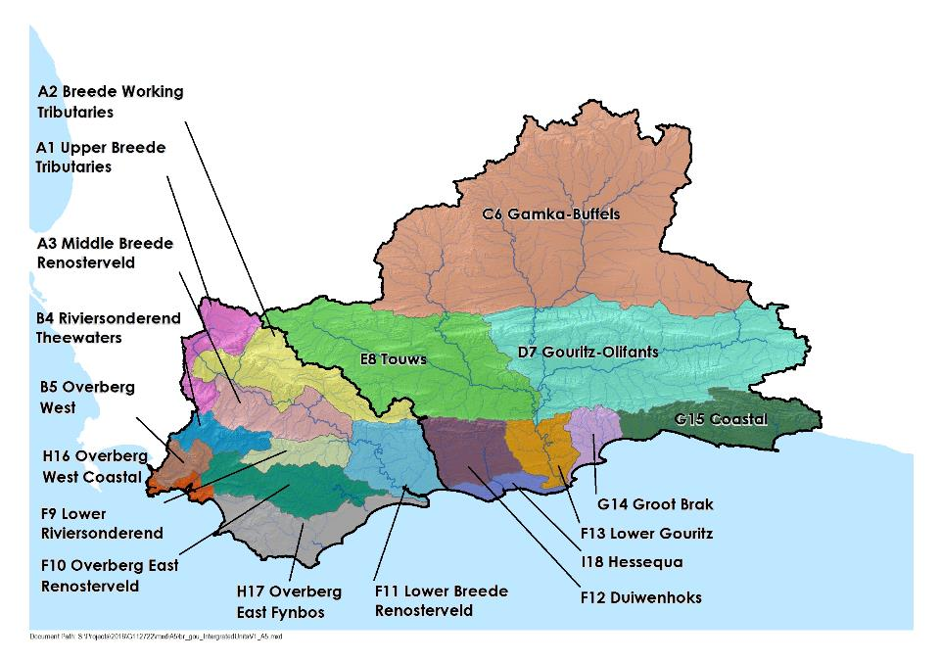
18 Integrated Units of Analysis

Slide 9
Defined Resource Units (RUs) and Nodes
Resource units (RUs) are grouped areas e.g. river basins, deemed similar in terms of various characteristics
Are used to transfer information between catchments
Groundwater
Nodes are locations of interest (points) in a water resource (rivers, dams, wetlands, estuaries)
Are sited using:
Water infrastructure
Aquatic ecosystem attributes
Are used to allocate water for environment and development

Slide 10
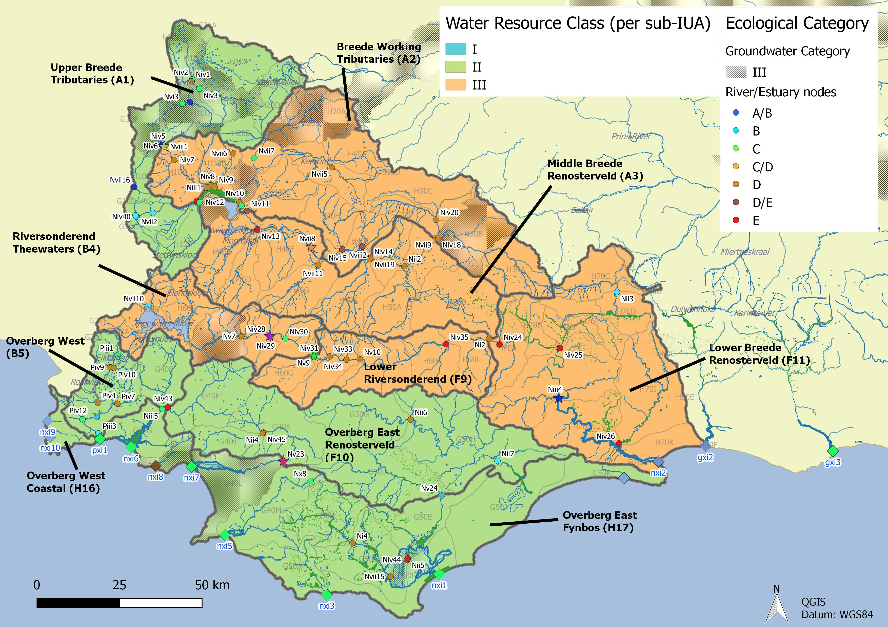
Integrated Units of Analysis and Nodes
Breede-Overberg Region

Slide 11
Breede-Overberg Region
 | Integrated Unit of Analysis (IUA) | Recommended Classes
 | A1 Upper Breede Tributaries | II
 | A2 Middle Breede Renosterveld | III
 | A3 Breede Working Tributaries | III
 | B4 Riversonderend Theewaters | III
 | F9 Lower Riversonderend | III
 | B5 Overberg West | II
 | H16 Overberg West Coastal | II
 | F10 Overberg East Renosterveld | II
 | H17 Overberg East Fynbos | III
 | F11 Lower Breede Renosterveld | II

Slide 12
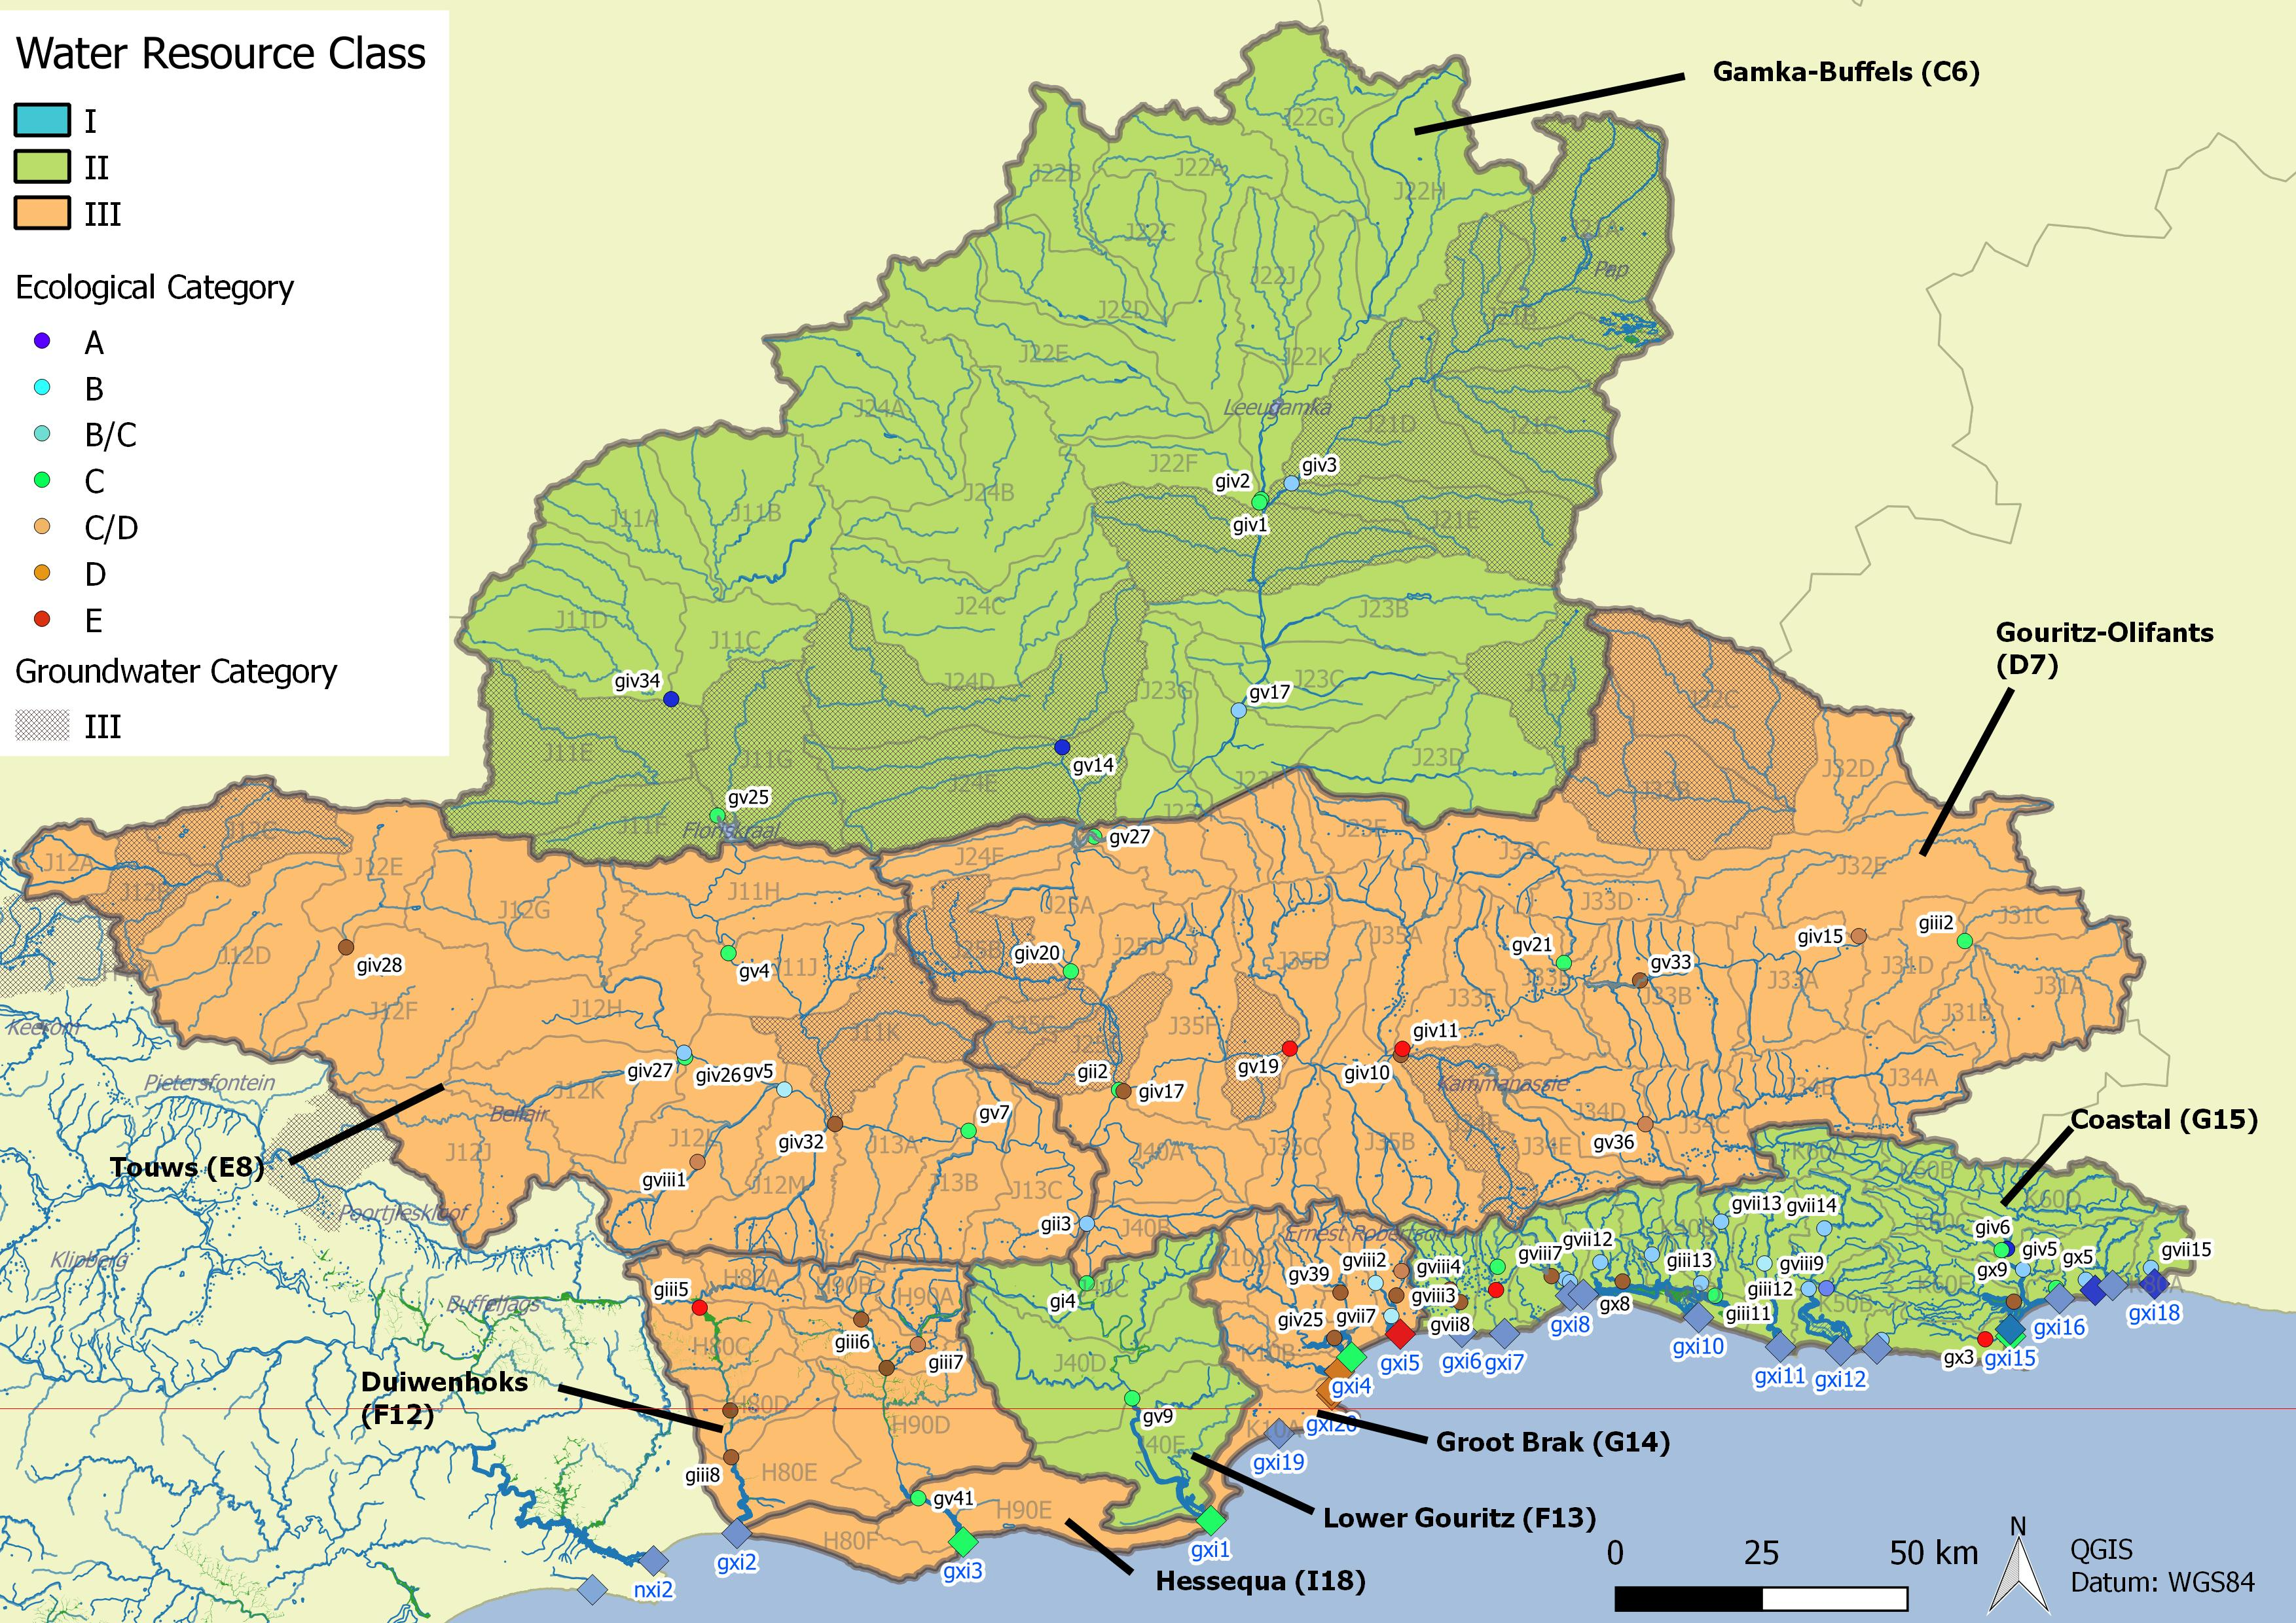
Integrated Units of Analysis and Nodes
Gouritz-Coastal Region

Slide 13
Gouritz-Coastal Region
 | Integrated Unit of Analysis (IUA) |  | Recommended Classes
 | Gamka Buffels | C6 | II
 | Touws | E8 | III
 | Gouritz-Olifants | D7 | III
 | Lower Gouritz | F13 | II
 | Duiwenhoks | F12 | III
 | Hessequa | I18 | III
 | Groot Brak | G14 | III
 | Coastal | G15 | II

Slide 14
Study Status: RQOs
DAMS
Draft
Complete
Draft
Complete
DAMS
Draft
Notes:
Erik to present progress, Reminder of two stage process (Classification followed be RQOs – but gazetted together). Link to RQOs? Then zoom in on the classification process

Slide 15
Comments on draft RQO Reports
Three RQO Reports disseminated for comment:
Resource Unit Prioritisation Report
Evaluation Resource Units Report
Outline of RQOs Report
Please provide comment by 22 March to:
Esther Lekalake (LekalakeE@dws.gov.za), or
Louise Lodenkemper (Louise.Lodenkemper@aurecongroup.com)

Slide 16
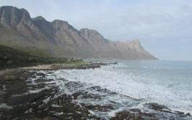
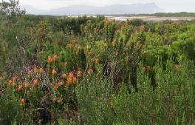
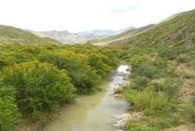
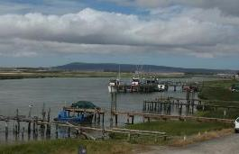
Thank you, Any discussion?

Slide 17
The Determination of Water Resources Classes and Resource Quality Objectives for the water resources in in the Breede-Gouritz WMA
Focus on Breede-Overberg area
Technical Task Group meeting 2: Presentation and workshopping of draft Resource Quality Objectives
RQOs for DAMS – Breede-Overberg area
Presented by: Erik van der Berg
13 March 2018
Graham & Rhona Beck Skills Centre, Robertson

Slide 18
18 Integrated Units of Analysis

Slide 19
Integrated Units of Analysis and Nodes
Breede-Overberg area

Slide 20
Resource Unit priorities - method
2 levels of ranking of resource units (RUs)
First level of screening:
Filter National List of Registered Dams (DWS Dam Safety Office) for the WMA - 717 dams
Select dams with High or Significant Hazard potential
Select Category 2 or 3 dams in terms of dam safety legislation
Select (significant) dams with a capacity of more than 5 million m³
27 dams selected in WMA
Notes:
Management only looks at nodes in poor condition and then EWR sites

Slide 21
Resource Unit priorities - method
Then the DWS RU Prioritisation Tool (RUPT) steps were followed that ranks RUs against one another based on:
position, socio-economic and international importance
role in regulating services and ecological importance
water quality threats
practical considerations
Notes:
Management only looks at nodes in poor condition and then EWR sites

Slide 22
RUPT Priority scores for dams (RUPT) : Breede-Overberg
Dams with “Priority Rating” ≥ 0.6 are prioritised
 | Theewaterskloof | Greater Brandvlei | Eikenhof | Kogelberg | Ceres Koekedouw | Rockview | Stettynskloof | Elandskloof | Lakenvallei | Poortjieskloof | Keerom | Roode Elsberg | De Bos | Arieskraal | Kraaibosch | Buffeljags
Position in IUA | 0.14 | 0.00 | 0.14 | 0.14 | 0.00 | 0.00 | 0.00 | 0.00 | 0.00 | 0.00 | 0.00 | 0.00 | 0.00 | 0.14 | 0.00 | 0.00
Concern for users | 0.21 | 0.21 | 0.14 | 0.18 | 0.16 | 0.11 | 0.09 | 0.09 | 0.09 | 0.07 | 0.07 | 0.05 | 0.05 | 0.05 | 0.05 | 0.07
Concern for environment | 0.29 | 0.29 | 0.00 | 0.29 | 0.14 | 0.00 | 0.00 | 0.00 | 0.00 | 0.00 | 0.00 | 0.00 | 0.00 | 0.29 | 0.00 | 0.00
Management and practical considerations | 0.14 | 0.14 | 0.14 | 0.14 | 0.14 | 0.09 | 0.09 | 0.14 | 0.14 | 0.14 | 0.14 | 0.14 | 0.09 | 0.12 | 0.09 | 0.14
Total Prioritization Score | 0.79 | 0.64 | 0.43 | 0.75 | 0.44 | 0.20 | 0.18 | 0.23 | 0.23 | 0.21 | 0.21 | 0.20 | 0.14 | 0.60 | 0.14 | 0.21
Relative Priority Rating | 1.0 | 0.8 | 0.5 | 1.0 | 0.6 | 0.3 | 0.2 | 0.3 | 0.3 | 0.3 | 0.3 | 0.3 | 0.2 | 0.8 | 0.2 | 0.3
Notes:
Evaluation Rus worked example

Slide 23
Prioritised dams
Breede-Overberg area
Theewaterskloof Dam
Greater Brandvlei Dam
Ceres-Koekedouw Dam
Kogelberg Dam
Arieskraal Dam
Gouritz-Coastal area
Stompdrift Dam
Wolwedans Dam
Notes:
Management only looks at nodes in poor condition and then EWR sites

Slide 24
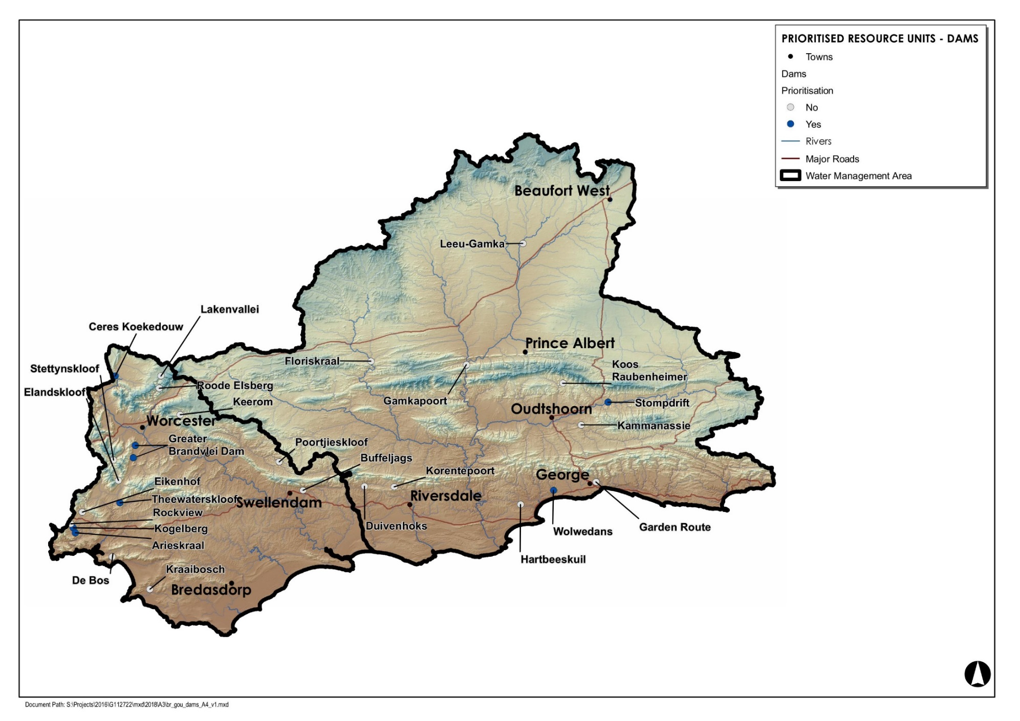
High and low priority RUs

Slide 25
Evaluation of RUs - method
Customised DWS RU Evaluation Tool used to identify selected indicators for prioritised RUs for which RQOs (descriptive and numerical) will be written, by identifying:
Components
Sub-components
Indicators
Notes:
Evaluation of Rus method statement

Slide 26
Evaluation of RUs - method
The evaluation criteria (applied in the RU Evaluation Tool) for each of the above indicators are:
Cumulative level of impact: This is the anticipated level of impact of current and future use/activities in the upstream catchments on the inflows to the dam and the quality, habitat and biota in the dam
Protection of the Resource: Rating of importance of components for the protection of the water resource, i.e. importance to releases of water for downstream EWRs
Water Resource Dependent Activities: Rating of importance of components for protection of in-dam activities and releases of water for downstream use (irrigation, domestic/rural supply, etc.)
Components with importance scores of 0.5 and higher were selected
Notes:
Evaluation of Rus method statement

Slide 27
Evaluation of RUs - method
Examples of:
Components-sub-components-indicators
Quantity low/high/maintenance flows, dam level
EWR
Quality nutrients, salts, system variables, toxics, pathogens
Ortho-phosphate, nitrogen, ammonium, EC
Habitat riparian habitat, in-dam habitat
None selected for dams
Biota fish, phytoplankton
Index of Reservoir Habitat Impairment (IRHI) by Miranda and Hunt (2011), fish health evaluation, chlorophyll a
Notes:
Evaluation of Rus method statement

Slide 28
EXAMPLE: Theewaterskloof Dam (IUA B4 Riviersonderend Theewaterskloof)
Largest dam in the Western Cape Province and main supply dam to the WCWSS. Significant transfers and supply for irrigation, urban and industrial use.
There are small upstream farm dams.
Releases are currently made for irrigation, urban, industrial and urban use from the dam into the river.

Slide 29
Theewaterskloof Dam (IUA B4 Riviersonderend Theewaters)

Slide 30
Theewaterskloof Dam (IUA B4 Riviersonderend Theewaterskloof)
Sub-comp. | Rationale for sub-component choice | Indicator selection
Low flows (QUANTITY) | Dam levels must remain sufficient to provide for transfers and releases for irrigation, urban, industrial and rural water use, as well as ecosystem function downstream. During the summer irrigation releases significantly exceed dry-season EWR flows. | EWR
High flows (QUANTITY) | During the wet season the dam levels must be maintained such that they are able to support releases for ecosystem function and for irrigation, urban, industrial and rural water use (outlet structure is limiting). | EWR
Nutrients (QUALITY) | The system must be maintained in a mesotrophic state or better. | Ortho-phosphate, nitrogen, ammonium
Salts (QUALITY) | Salt levels must be maintained at concentrations where they do not impact negatively on the ecosystem and are acceptable for municipal treatment and rural use. | Electrical conductivity
Fish (BIOTA) | The wellbeing of the fish community of this artificial ecosystem must be maintained in a suitable condition to contribute to regional biodiversity and to support local recreational angling industry. The re-infestation of alien species from the dam(upstream) should be prevented. Consumption of fish must not pose a health risk. | Implementation of the Index of Reservoir Habitat Impairment (IRHI) by Miranda and Hunt (2011), fish health evaluation
Phytoplank-ton (BIOTA) | The system must be maintained in a mesotrophic state or better. | Chlorophyll a
Can the situation be improved?
Realistic to try and meet high-flow EWR?

Slide 31
Outline of RQOs - method
Targeted Ecological Category (TEC) = Spatially Targeted Scenario, where info is available
5 high priority RUs in the Breede-Overberg area
Evaluate present status and suitability of data
For the selected sub-components and indicators of each dam:
Write descriptive RQOs (narratives)
Set numerical limits
Set Thresholds of Potential Concern (TPCs)
Notes:
RQOs method statement

Slide 32
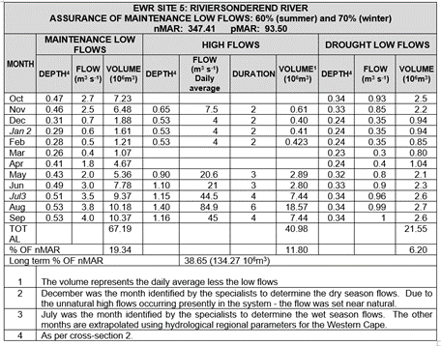
Quantity & Biota RQOs for Theewaterskloof Dam
Sub-comp. | RQO Narrative description | Indicator/ measure | Numerical limits | TPC
Low flows | During the dry season dam levels must be sufficient for releases for irrigation and human use and protection of ecosystem function downstream. | Flow releases: Breede EWR5 in H60F nMAR = 347.41 million m³/a pMAR = 93.50 million m³/a REC = D category | Breede EWR 5 site in Riviersonderend River – specified flows | Not applicable
High flows | During the wet season dam levels must be maintained such that they support ecosystem function and human use, within the constraint of dam outlet structures.
Fish | The wellbeing of the fish community of this artificial ecosystem must be maintained in a suitable condition to contribute to, or not impact negatively on regional biodiversity and to support the local recreational angling industry. The re-infestation of alien species upstream from the dam should be prevented. Consumption of fish must not pose a health risk. | Implementation of the Index of Reservoir Habitat Impairment (IRHI) by Miranda and Hunt (2011) | Habitat suitability and fish wellbeing in a state which is equivalent to a D or better ecological category. | Habitat suitability and fish wellbeing (FRAI) in a state worse than a D ecological category

Slide 33
Quantity Numerical Limits for Theewaterskloof Dam

Slide 34
Quality RQOs for Theewaterskloof Dam
Sub-comp. | RQO Narrative description | Indicator | Numerical Limits | Threshold of Potential Concern | Present state (50/95%tile) H6R001Q01
Nutrients | The system must be maintained in a mesotrophic state or better | Ortho-phosphate (PO₄-P) | Median ≤ 0.015 mg/ ℓ P | 0.020 mg/ ℓ P | PO4 0.005 / 0.014
 |  | Total inorganic nitrogen (TIN) | Median ≤ 1.50 mg/ℓ N | 1.3 mg/ℓ N | TIN 0.19 / 0.484
Salts | Salt levels must be maintained at concentrations where they do not impact negatively on the ecosystem and are in an Ideal category for domestic water supply | Electrical conductivity | 95th percentile ≤ 70 mS/m | 60 mS/m | EC 8 / 11
Pathogens | Maintain in Acceptable cat (contact recreation) | E coli / Faecal coliforms | Median ≤ 130 cfu/100ml | 110 cfu/100ml | No data
Phytoplancton | The system must be maintained in a mesotrophic state or better | Chlorophyll a | Median ≤ 20 µg/ℓ Chl a | Chl a ≤ 15 µg/ℓ | 2.5 µg/ℓ

Slide 35
Greater Brandvlei Dam (IUA A2 Breede Working Tributaries)
This is largely an off-channel dam (impounds the small lower Brandvlei River) with limited natural inflow, and with limited farm dams located upstream. During the dry season significant irrigation releases are made.
The important Papenkuils floodplain wetland is located just upstream of the dam, below the canal off-takes from the Smalblaar and Holsloot rivers.
Water in the dam is mainly used for irrigation along the Breede River and for urban and rural use. Irrigation water is distributed by a system of canals receiving water directly from the dam as well as pumps and canals abstracting released water downstream.
Freshening releases are made to reduce salinity (22 million m³/a) in the middle and lower reaches of the Breede River, with some of this water being used opportunistically for irrigation in the lower reaches of the Breede River. The significant recreational activities include abseiling, sailing, kayaking and fishing, among others.

Slide 36
Greater Brandvlei Dam (IUA A2 Breede Working Tributaries)

Slide 37
Greater Brandvlei Dam (IUA A2 Breede Working Tributaries)
Sub-comp. | Rationale for sub-component choice | Indicator selection
Low flows | Dam levels must remain sufficient to make releases for irrigation, as well as releases for ecosystem function downstream. | EWR
High flows | During the wet season the dam levels must be maintained such that they are able to support releases for ecosystem function and for irrigation (outlet structure is limiting). During the summer irrigation releases significantly exceed dry season EWR flows. | EWR
Nutrients | The system must be maintained in an oligotrophic state. | Ortho-phosphate, nitrogen, ammonium
Salts | Salt levels must be maintained at concentrations where they do not impact negatively on the ecosystem. | Electrical conductivity
Fish | The wellbeing of the fish community of this artificial ecosystem must be maintained in a suitable condition to contribute to regional biodiversity and to support local recreational angling industry. The re-infestation of alien species from the dam should be prevented. Consumption of fish must not pose a health risk. | Implementation of the Index of Reservoir Habitat Impairment (IRHI) by Miranda and Hunt (2011), fish health evaluation

Slide 38
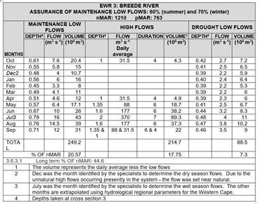
Quantity & Biota RQOs for Greater Brandvlei Dam
Sub-comp. | RQO Narrative description | Indicator/ measure | Numerical limits | TPC
Low flows | During the dry season dam levels must be sufficient for releases for irrigation and human use and protection of ecosystem function downstream. Dependent on whether increased summer base flows, lack of flow variability and turbid water can be managed. Flow releases made to manage salinity. | Flow releases: Breede EWR3 in H40F nMAR = 1210 million m3/a pMAR: 763 million m3/a REC = CD category | Breede EWR 3 site in Breede River – specified flows | Not applicable
High flows | During the wet season dam levels must be maintained such that they support ecosystem function, irrigation and human use, within the constraint of dam outlet structures.
Fish | The wellbeing of the fish community of this artificial ecosystem must be maintained in a suitable condition to contribute to regional biodiversity and to support the local recreational angling industry. Consumption of fish must not pose a health risk. | Implementation of the Index of Reservoir Habitat Impairment (IRHI) by Miranda and Hunt (2011) | Habitat suitability and fish wellbeing in a state which is equivalent to a D or better ecological category. | Habitat suitability and fish wellbeing (FRAI) in a state worse than a D ecological category.

Slide 39
Quantity Numerical Limits for Greater Brandvlei Dam

Slide 40
Quality RQOs for Greater Brandvlei Dam
Sub-comp. | RQO Narrative description | Indicator | Numerical Limits | Threshold of Potential Concern | Present state (50/95%tile) H1R001Q01
Nutrients | The system must be maintained in an oligotrophic state | Ortho-phosphate (PO₄-P) | Median ≤ 0.015 mg/ ℓ P | 0.010 mg/ ℓ P | PO4 0.005 / 0.025
 |  | Total inorganic nitrogen (TIN) | Median ≤ 0.70 mg/ℓ N | 0.60 mg/ℓ N | TIN 0.05 / 0.208
Salts | Salt levels must be maintained at concentrations where they do not impact negatively on the ecosystem, and are acceptable for rural use, and in an Ideal category for irrigation water use | Electrical conductivity | 95th percentile ≤ 40 mS/m | 35 mS/m | EC 8 / 12
Phytoplankton | The system must be maintained in an oligotrophic state | Chlorophyll a | Median ≤ 10 µg/ℓ Chl a | Chl a ≤ 8 µg/ℓ | 6 µg/ℓ

Slide 41
Ceres Koekedouw Dam (IUA A1 Upper Breede Tributaries)
The dam supplies water for irrigation (Ceres-Koekedouw WUA), and to the town of Ceres for urban and industrial water use.
The dam is located in a mountainous area. A number of small dams are located in the upstream irrigation areas which will impound low flows. No change is expected for future impacts.
While there is no EWR site located downstream, the construction of the dam was approved subject to the release of environmental water requirements which are being implemented and monitored to some extent.

Slide 42
Ceres Koekedouw Dam (IUA A1 Upper Breede Tributaries)

Slide 43
Ceres Koekedouw Dam (IUA A1 Upper Breede Tributaries)
Sub-comp. | Rationale for sub-component choice | Indicator selection
Low flows
Nutrients | The system must be maintained in a mesotrophic state or better | Ortho-phosphate, nitrogen, ammonium
Salts | Salt levels must be maintained at concentrations where they do not impact negatively on the ecosystem and are acceptable for municipal treatment | Electrical conductivity
Fish | The wellbeing of the fish community of this artificial ecosystem must be maintained in a suitable condition to contribute to regional biodiversity. Consumption of fish must not pose a health risk | Implementation of the Index of Reservoir Habitat Impairment (IRHI) by Miranda and Hunt (2011), fish health evaluation

Slide 44
Quantity & Biota RQOs for Ceres Koekedouw Dam
Sub-comp. | RQO Narrative description | Indicator/ measure | Numerical limits | TPC
Low flows | During the dry season dam levels must be sufficient for releases for human use and protection of ecosystem function downstream | Dam levels must be sufficient to maintain releases for urban and industrial use and agreed flow releases (no EWR) to the lower Koekedouw River in H10C Flow releases for recommended scenario (Spatially Targeted scenario, 2018) for node Niv1 in lower Koekedouw River | Agreed ecological release flow pattern and rate (condition of dam raising). Current: PES (2014) = D and %nMAR = 96.32 Spatially targeted: EC = D and %nMAR = 96.32 | Not applicable
Fish | The wellbeing of the fish community of this artificial ecosystem must be maintained in a suitable condition to contribute to regional biodiversity and to support local recreational angling. Consumption of fish must not pose a health risk | Implementation of the Index of Reservoir Habitat Impairment (IRHI) by Miranda and Hunt (2011) | Habitat suitability and fish wellbeing in a state which is equivalent to a C or better ecological category | None
Keep or discard?

Slide 45
Quality RQOs for Ceres Koekedouw Dam
Sub-comp. | RQO Narrative description | Indicator | Numerical Limits | Threshold of Potential Concern | Present state (50/95%tile) H1R003Q01
Nutrients | The system must be maintained in an oligotrophic state or better. | Ortho-phosphate (PO₄-P) | Median ≤ 0.015 mg/ ℓ P | 0.010 mg/ ℓ P | PO4-P 0.007 / 0.017
 |  | Total inorganic nitrogen (TIN) | Median ≤ 0.70 mg/ℓ N | 0.60 mg/ℓ N | TIN 0.12 / 0.27
Salts | Salt concentrations are low, in an Ideal category for all uses. There is a slight increasing trend but it is well within the Ideal range. Trends should be stabilised. | Electrical conductivity | 95th percentile ≤ 40 mS/m | 35 mS/m | EC 4.6 / 8.8
Pathogens | E coli and Faecal coliforms should be maintained in an Ideal category for contact recreation | E coli Faecal coliforms | 95th percentile ≤ 130 cfu/100ml | 100 cfu/100ml | No data

Slide 46
Kogelberg Dam (IUA B5 Overberg West)
Applethwaite Dam is located directly upstream and Arieskraal Dam a short river stretch downstream. Flow conditions are significantly modified. The low-flows are reduced by Eikenhof Dam and the significant upstream irrigation development and farm dams and the town of Grabouw located directly upstream of the series of 3 dams.
Together with the off-channel Rockview Dam on the watershed dividing the Palmiet from the Steenbras River catchments, the dam comprises part of the Palmiet Pumped Storage Scheme that generates 400 MW of power for distribution to the Cape Metropolitan Area over peak periods (weekdays).
During winter, once flows measured at the Campanula weir (G4H030) reach or exceed 4.33 m³/s (the wet season low flow capping discharge), water is transferred to Rockview Dam and stored there for allocating water to the Cape Metropolitan Area via the Steenbras Dam (22.5 million m³/a). Managed high-flow releases from the combined Kogelberg and Arieskraal dams are restricted by the capacities of the existing outlet works at these dams. Kogelberg Dam can release a maximum of 15 m³/s whilst Arieskraal Dam has no release mechanism and any flood flows in the Palmiet River downstream are only achieved through spillage. Groenland WUA operates the system in accordance with the Palmiet River CMP.

Slide 47
Kogelberg Dam (IUA B5 Overberg West)

Slide 48
Kogelberg Dam (IUA B5 Overberg West)
Sub-comp. | Rationale for sub-component choice | Indicator selection
Low flows | Dam levels must remain sufficient for hydro-electric generation, and to provide for the transfer of water for urban and industrial use | Dam levels
Nutrients | The system must be maintained in a mesotrophic state or better | Ortho-phosphate, nitrogen, ammonium
Pathogens | The system must be maintained in a state that is safe for contact recreation | E coli and/or Faecal coliforms
Fish | The wellbeing of the fish community of this artificial ecosystem must be maintained in a suitable condition to contribute to regional biodiversity. Consumption of fish must not pose a health risk | Implementation of the Index of Reservoir Habitat Impairment (IRHI) by Miranda and Hunt (2011), fish health evaluation

Slide 49
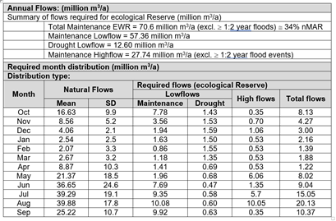
Quantity & Biota RQOs for Kogelberg Dam
Sub-comp. | RQO Narrative description | Indicator/ measure | Numerical limits | TPC
Low flows | During the dry season dam levels must be sufficient for energy generation and transfers for urban and industrial use and protection of ecosystem function downstream of Arieskraal Dam. | Releases to ensure spills from Arieskraal Dam. Flow releases: Palmiet EWR3 in G40D below Arieskraal Dam nMAR = 207 million m3/a pMAR: 135 million m3/a REC = B/C category |  | Not applicable
Fish | The wellbeing of the fish community must be maintained in a suitable condition to contribute to regional biodiversity and to support local recreational angling. Consumption of fish must not pose a health risk. | Implementation of the Index of Reservoir Habitat Impairment (IRHI) by Miranda and Hunt (2011) | Habitat suitability and fish wellbeing in a state which is equivalent to a D or better ecological category. | Habitat suitability and fish wellbeing (FRAI) in a state worse than a D ecological category.

Slide 50
Quantity Numerical Limits for Kogelberg Dam

Slide 51
Quality RQOs for Kogelberg Dam
Sub-comp. | RQO Narrative description | Indicator | Numerical Limits | Threshold of Potential Concern | Present state (50/95%tile) G4R001Q01
Nutrients | The system must be maintained in a mesotrophic state or better | Ortho-phosphate (PO₄-P) | Median ≤ 0.025 mg/ ℓ P | 0.020 mg/ ℓ P | PO4-P 0.016 / 0.030
 |  | Total inorganic nitrogen (TIN) | Median ≤ 1.00 mg/ℓ N | 0.90 mg/ℓ N | TIN 0.268 / 0.619
Pathogens | The system must be maintained in a state that is safe for municipal use and contact recreation | E. coli | ≤ 130 counts/100 ml | 100 counts/100 ml | No data
 |  | Faecal coliforms | ≤ 130 counts/100 ml | 100 counts/100 ml

Slide 52
Arieskraal Dam (IUA B5 Overberg West)
Kogelberg Dam is located a very short river stretch upstream. Flow conditions are significantly modified. The low-flows are reduced by Eikenhof Dam and the significant upstream irrigation development and farm dams and the town of Grabouw located directly upstream of the series of 3 dams.
Most of the catchment below the dam is located in the Kogelberg Nature Reserve, which is also managed as a biosphere reserve (Kogelberg Biosphere Reserve). Implementation of the EWR is thus of the highest priority. The Biosphere Reserve is marked by an extraordinarily high level of floral diversity and a wide diversity of terrestrial and freshwater habitats.
Managed high-flow releases from the combined Kogelberg and Arieskraal dams are restricted by the capacities of the existing outlet works at these dams. Flood flows in the Palmiet River downstream are currently only achieved through spillage. Arieskraal Dam’s outlet pipe can release up to 2 m³/s but an orifice plate has been bolted onto the outlet pipe which prevents any variation in releases from the dam. Changes to this outlet structure is recommended, which would firstly allow for the EWR entering the Kogelberg/Arieskraal dams to be released downstream and secondly allow for greater variation in flow to be provided, albeit within the constraint of a maximum discharge of 2 m³/s.
Groenland WUA operates the system in accordance with the Palmiet River CMP.

Slide 53
Arieskraal Dam (IUA B5 Overberg West)

Slide 54
Arieskraal Dam (IUA B5 Overberg West)
Sub-comp. | Rationale for sub-component choice | Indicator selection
Low flows | Dam levels must remain sufficient to provide for irrigation surrounding the dam, as well as releases for ecosystem function downstream. | EWR
Nutrients | The system must be maintained in a mesotrophic state or better. | Ortho-phosphate, nitrogen, ammonium
Pathogens | The system must be maintained in a state that is safe for contact recreation. | E coli and/or Faecal coliforms
Fish | The wellbeing of the fish community of this artificial ecosystem must be maintained in a suitable condition to contribute to regional biodiversity. Consumption of fish must not pose a health risk. | Implementation of the Index of Reservoir Habitat Impairment (IRHI) by Miranda and Hunt (2011), fish health evaluation

Slide 55
Quantity & Biota RQOs for Arieskraal Dam
Sub-comp. | RQO Narrative description | Indicator/ measure | Numerical limits | TPC
Low flows | During the dry season dam levels must be sufficient for releases for human use and protection of ecosystem function downstream | Spills from dam. Flow releases: Palmiet EWR3 in G40D below Arieskraal Dam nMAR = 207 million m3/a pMAR: 135 million m3/a REC = B/C category |  | Not applicable
Fish | The wellbeing of the fish community must be maintained in a suitable condition to contribute to regional biodiversity and to support local recreational angling. Consumption of fish must not pose a health risk | Implementation of the Index of Reservoir Habitat Impairment (IRHI) by Miranda and Hunt (2011) | Habitat suitability and fish wellbeing in a state which is equivalent to a D or better ecological category | Habitat suitability and fish wellbeing (FRAI) in a state worse than a D ecological category

Slide 56
Quantity Numerical Limits for Arieskraal Dam

Slide 57
Quality RQOs for Arieskraal Dam
Sub-comp. | RQO Narrative description | Indicator | Numerical Limits | Threshold of Potential Concern | Present state (50/95%tile) H1H006Q01
Nutrients | The system must be maintained in a mesotrophic state or better. | Ortho-phosphate (PO₄-P) | Median ≤ 0.025 mg/ ℓ P | 0.020 mg/ ℓ P | PO4-P 0.016 / 0.036
 |  | Total inorganic nitrogen (TIN) | Median ≤ 1.00 mg/ℓ N | 0.90 mg/ℓ N | TIN 0.434 / 0.755
Pathogens | The system must be maintained in a state that is safe for contact recreation. | E. coli | ≤ 130 counts/100 ml | 100 counts/100 ml | No data
 |  | Faecal coliforms | ≤ 130 counts/100 ml | 100 counts/100 ml

Slide 58
Thank you!

Slide 59
ADDITIONAL SLIDES

Slide 60
Methodology for Determination of RQOs
Notes:
Erik and team to present the methodology used for scenario evaluation

Slide 61
Integrated Units of Analysis
Socio-economic Zone | Zone Code | River Resource Unit | IUA Name | IUA Code
Upper and Middle Breede | A | Upper Breede Tributaries | Upper Breede Tributaries | A1
 |  | Breede Working | Breede Working Tributaries | A2
 |  | Middle Breede Renosterveld | Middle Breede Renosterveld | A3
Upper Riversonderend and Palmiet | B | Riviersonderend Upper | Riviersonderend Theewaters | B4
 |  | Overberg West (part 1 of 3) | Overberg West | B5
Great Karoo | C | Groot/Touws (part 1 of 2) | Gamka-Buffels | C6
 |  | Gamka (part 1 of 2)
Little Karoo West | D | Lower Gouritz (part 1 of 2) | Gouritz-Olifants | D7
 |  | Olifants
Little Karoo East | E | Groot/Touws (part 2 of 2) | Touws | E8
Wheat belt | F | Riviersonderend Lower | Lower Riviersonderend | F9
 |  | Overberg West (part 2 of 3) | Overberg East Renosterveld | F10
 |  | Overberg East Renosterveld (part 1 of 2)
 |  | Lower Breede Renosterveld | Lower Breede Renosterveld | F11
 |  | Duiwenhoks (1 of 2) | Duiwenhoks | F12
Garden Route coast | G | Coastal Rivers (1 of 2) | Groot Brak | G14
 |  | Coastal Rivers (2 of 2) | Coastal | G15
Overberg coast | H | Overberg West (3 of 3) | Overberg West Coastal | H16
 |  | Overberg East (Fynbos) | Overberg East Fynbos | H17
Hessequa coast | I | Duiwenhoks (2 of 2) | Hessequa | I18

Slide 62
Integrated Units of Analysis and Nodes
Gouritz-Coastal Region

Slide 63
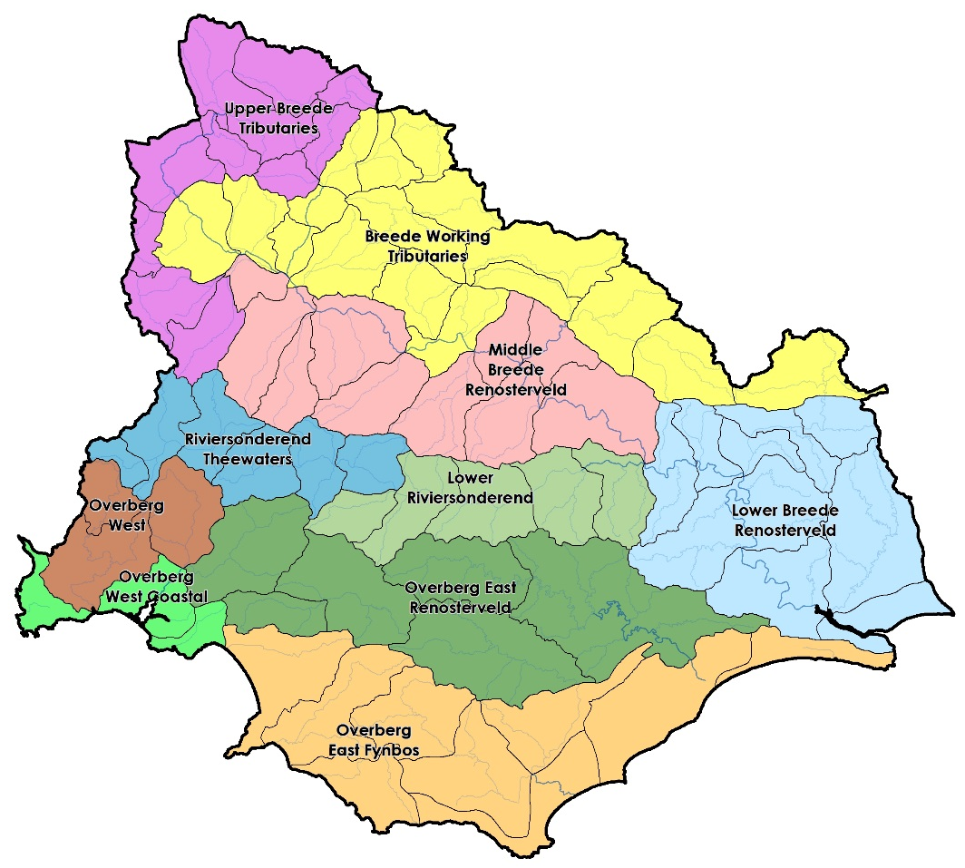
Integrated Units of Analysis
Breede-Overberg area
Delineated by a combination of socio-economic and biotic boundaries
Notes:
Part of the purpose is to try focus attention at all the areas of the basin that differ from one another…to be representative as a whole across the basin

Slide 64
Resource Unit priorities - method
Prioritisation Criteria evaluated in RU Prioritisation Tool:
Location in river system
Importance to users, such as recreational use, tourism, scientific benefits, aesthetic, cultural or spiritual benefits
Does it support the livelihoods of significant vulnerable communities, such as water, food or grazing and raw materials
Strategic or international obligations, for the generation of power, or for water-related agreements, such as the RAMSAR convention
Provision of supporting or regulating services, such as water supply, flood attenuation, water quality control, stream flow regulation, and sediment retention, apart from the common function of water storage
Contribution to economy
Ecological importance of RU, linked to flow releases for ecological purposes
Level of threat posed to the water quality for the environment
Practical considerations, such as the existence of EWR sites and DWS gauging weirs
Notes:
Management only looks at nodes in poor condition and then EWR sites

Slide 65
Prioritisation Criteria evaluated in RU Prioritisation Tool
Location in river system
Importance to users
Level of support of livelihoods of vulnerable communities,
Strategic or international obligations
Provision of supporting or regulating services
Contribution to the economy
Ecological importance of RU i.t.o. flow releases
Level of threat posed to water quality
Practical considerations
Notes:
Management only looks at nodes in poor condition and then EWR sites

Slide 66
RUPT Priority scores for dams: Gouritz-Coastal
Dams with “Priority Rating” ≥ 0.6 are prioritised
 | Stompdrift | Floriskraal | Gamkapoort | Kammanassie | Wolwedans | Leeu-Gamka | Koos Raubenheimer | Korentepoort | Garden Route | Hartbeeskuil | Duivenhoks
Position in IUA | 0.14 | 0.00 | 0.14 | 0.00 | 0.00 | 0.00 | 0.00 | 0.00 | 0.00 | 0.00 | 0.00
Concern for users | 0.16 | 0.14 | 0.04 | 0.16 | 0.20 | 0.07 | 0.11 | 0.07 | 0.11 | 0.11 | 0.07
Concern for environment | 0.00 | 0.00 | 0.00 | 0.00 | 0.36 | 0.00 | 0.00 | 0.00 | 0.07 | 0.00 | 0.00
Management and practical considerations | 0.14 | 0.14 | 0.12 | 0.14 | 0.14 | 0.09 | 0.12 | 0.09 | 0.14 | 0.14 | 0.09
Total Prioritization Score | 0.44 | 0.28 | 0.30 | 0.30 | 0.70 | 0.16 | 0.22 | 0.16 | 0.32 | 0.25 | 0.16
Relative Priority Rating | 0.6 | 0.4 | 0.4 | 0.4 | 0.9 | 0.2 | 0.3 | 0.2 | 0.4 | 0.3 | 0.2
Notes:
Evaluation Rus worked example

